Slide 1

Residential Modeling
This section will cover how to create a simple model of residential buildings

Slide 2
Topics covered
House model
Multiple homes
Weather data
Schedules
Loadshapes
Appliances
Controls

Slide 3
Two kinds of models
House A (ASHRAE)
  Class name is house
  Based on CLTD model
  Largely ignores mass effects
House E (ETP)
  Class is name is house_e
  Equivalent thermal parameters model
  Incorporate mass effects
Appliance models included in module

Slide 4
Residential ETP model
HVAC
Internal
Gains
Sun
Q_{hvac}
Q_{gains}
Q_{solar}
T_{set}
Total
heat
Q_{mass}
Q_{air}
T_{out}
UA_{env}
T_{air}
UA_{mass}
T_{mass}
C_{air}
C_{mass}

Slide 5
House parameters
House A and House E very similar
Most differences are in calculation method
House A support explicit appliances
  Separate objects with various models
  Shape driven
House E supports intrinsic appliances
  Built-in shapes
  External shapes can be used optionally

Slide 6
House design parameters
double floor_area[sf]; // home conditioned floor area
double gross_wall_area[sf]; // gross outdoor wall area
double ceiling_height[ft]; // average ceiling height
double aspect_ratio; // aspect ratio of the home's footprint
double envelope_UA[Btu/degF]; // overall UA of the home's envelope
double window_wall_ratio; // ratio of window area to wall area
double door_wall_ratio; // ratio of door area to wall area
double glazing_shgc; // (DEPRECATED) shading coefficient of glazing
double window_shading; // shading coefficient of windows
double airchange_per_hour; // number of air-changes per hour
double mass_heat_capacity[Btu/degF]; // interior mass heat capacity
double mass_heat_coeff[Btu/degF]; // interior mass heat exchange coefficient
double air_volume[cf]; // air volume
double air_mass[lb]; // air mass
double air_heat_capacity[Btu/degF]; // air thermal mass
double latent_load_fraction[pu]; // fractional increase in cooling load due to latent heat
double Rroof[degF]; // roof R-value
double Rwall[degF]; // wall R-value
double Rfloor[degF]; // floor R-value
double Rwindows[degF]; // window R-value
double Rdoors[degF]; // total panel enduse load

Slide 7
Heating/AC parameters
set {TWOSTAGE=8, FORCEDAIR=4, AIRCONDITIONING=2, GAS=1} system_type; // heating/cooling system type/options
double thermostat_deadband[degF]; // deadband of thermostat control
double heating_setpoint[degF]; // thermostat heating setpoint
double cooling_setpoint[degF]; // thermostat cooling setpoint
double design_heating_capacity[Btu]; // system heating capacity
double design_cooling_capacity[Btu]; // system cooling capacity
double cooling_design_temperature[degF]; // system cooling design temperature
double heating_design_temperature[degF]; // system heating design temperature
double design_peak_solar[W/sf]; // system design solar load
double design_internal_gains[W/sf]; // system design internal gains
double air_heat_fraction[pu]; // fraction of heat gain/loss that goes to air (as opposed to mass)
double heating_COP[pu]; // system heating performance coefficient
double cooling_COP[Btu/kWh]; // system cooling performance coefficient

Slide 8
Internal state variables
enumeration {AUX=3, COOL=4, OFF=1, HEAT=2, UNKNOWN=0} system_mode; // heating/cooling system operation state
double COP_coeff; // effective system performance coefficient
double air_temperature[degF]; // indoor air temperature
double outdoor_temperature[degF]; // outdoor air temperature
double mass_temperature[degF]; // interior mass temperature
double internal_gain[Btu/h]; // internal heat gains
double solar_gain[Btu/h]; // solar heat gains
double heat_cool_gain[Btu/h]; // system heat gains(losses)

Slide 9
Standard load parameters
complex panel.energy[kVAh]; // the total energy consumed since the last meter reading
complex panel.power[kVA]; // the total power consumption of the load
complex panel.peak_demand[kVA]; // the peak power consumption since the last meter reading
double panel.heatgain[Btu/h]; // the heat transferred from the enduse to the parent
double panel.heatgain_fraction[pu]; // the fraction of the heat that goes to the parent
double panel.current_fraction[pu]; // the fraction of total power that is constant current
double panel.impedance_fraction[pu]; // the fraction of total power that is constant impedance
double panel.power_fraction[pu]; // the fraction of the total power that is constant power
double panel.power_factor; // the power factor of the load
complex panel.constant_power[kVA]; // the constant power portion of the total load
complex panel.constant_current[kVA]; // the constant current portion of the total load
complex panel.constant_admittance[kVA]; // the constant admittance portion of the total load
double panel.voltage_factor[pu]; // the voltage change factor

Slide 10
Appliances
Waterheater
Lights
Refrigerator
Clotheswasher
Dishwasher
Plugs
Microwave
Range
Freezer
Dryer
Evcharger
Occupants

Slide 11
Problem 1 - A single house
Problem S1_1
Build a single house model with only a waterheater and run it for one day in January with an outdoor air temperature of 50F.
Plot the result power consumption on screen.

Slide 12
Create a new file
Open a new file
Textpad users, be sure to set file type to GLM before saving to prevent TXT from being used

Slide 13
Specify the modules
residential is used to models homes
tape is used to collect and plot data
module residential {
implicit_enduses WATERHEATER;
default_outdoor_temperature 50;
}
module tape;

Slide 14
Setup the global clock
clock directive establishes timezone, start, and end times of simulation
clock {
timezone PST+8PDT;
starttime '2009-01-01 0:00:00 PST';
stoptime '2009-01-02 0:00:00 PST';
}

Slide 15
Define the house
Give the house it's basic features like name and square-footage
object house {
name MyHouse;
floor_area 2000 sf;
}

Slide 16
Specify output
Plot house power transients on screen
object recorder {
parent MyHouse;
property panel.power;
interval -1;
file plot:output.plt;
output SCREEN;
}

Slide 17
Nesting objects
object house {
name MyHouse;
floor_area 2000 sf;
object recorder {
  parent MyHouse;
  property panel.power;
  interval -1;
  file plot:output.plt;
  output SCREEN;
  };
}

Slide 18
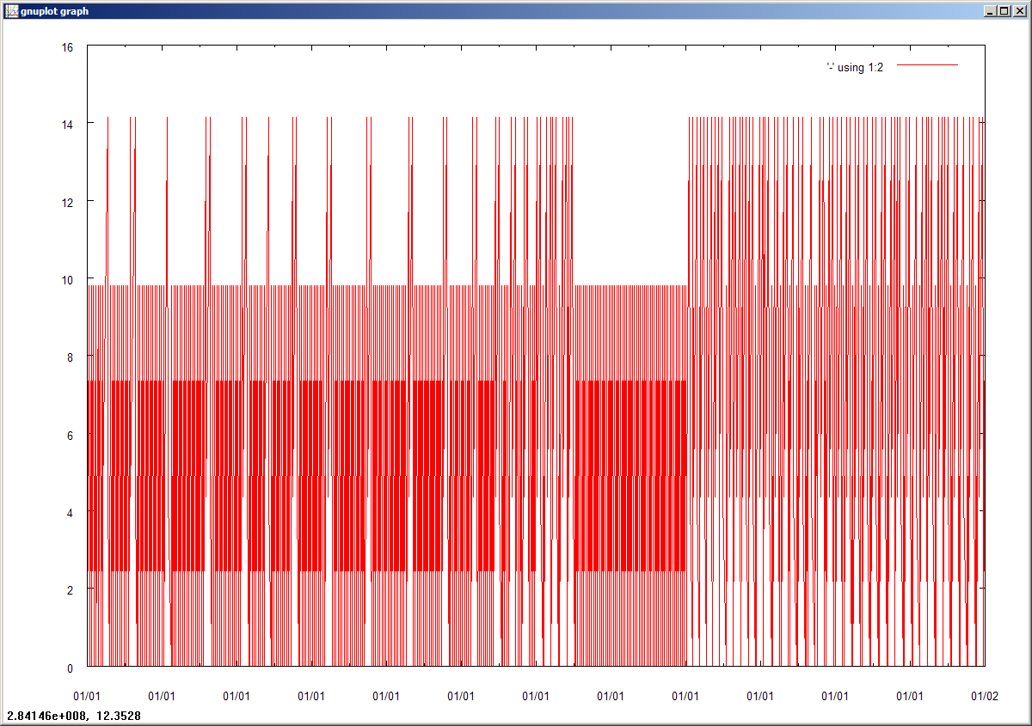
Run simulation

Slide 19
Problem 2 – Multiple homes
Problem S1_2
Model 10 houses with lights and plugs that are between 1500 and 2500 sf and run them for the last week of January in Portland OR
Collect the total power consumption to a CSV file.

Slide 20
Specify the new end-uses
module residential {
implicit_enduses LIGHTS|PLUGS;
default_outdoor_temperature 50;
}
module tape;

Slide 21
Change the clock
clock {
timezone PST+8PDT;
starttime '2009-01-24 0:00:00 PST';
stoptime '2009-02-01 0:00:00 PST';
}

Slide 22
Load to city data
#include "OR-Portland.glm"

Slide 23
Define multiple houses
object house:..10 {
floor_area random.triangle(1500,2500);
object recorder {
...
};
}

Slide 24
Collect the total power
object collector {
group "class=house";
property "sum(panel.power.mag)";
interval 3600;
file output.csv;
}

Slide 25
Schedules
Defines a time-dependent value with up to 1 minute resolution
Use cron style of specification
schedule name {
minutes hours days months weekdays [value]
[...]
}

Slide 26
Schedule blocks
Divides schedule into normalizable blocks
schedule name {
[normal;] [weighted;] [absolute;]
blockname1 {…}
blockname2 {…}
[…]
}

Slide 27
Normalization parameters
Specifies how the blocks are normalized
normal – enables normalization
absolute – uses absolute values only
weighted – uses time-weighting

Slide 28
Problem 3 - Schedules
Problem S1_3
Modify S1_2 so that the houses are on a 66F/70F setback schedule between 8am and 6pm.
Collect the total power consumption and thermostat setting range to a CSV file.

Slide 29
Add the setback schedule
schedule thermostat_setback {
* 8-18 * * * 66
* 19-7 * * * 70
}

Slide 30
Link the setpoint to schedule
object house:..10 {
system_type AIRCONDITIONING|FORCEDAIR;
floor_area random.triangle(1500,2500);
heating_setpoint thermostat_setback;
}

Slide 31
Collect thermostat info
object collector {
group "class=house";
property "mean(heating_setpoint),std(heating_setpoint)";
interval 3600;
file output.csv;
}

Slide 32
Schedule ransforms
Defines a property as a linear function of a schedule:
value scalar * schedule + offset;

Slide 33
Problem 4 - Transforms
Problem S1_4
Starting with S1_3, make both thermostat setpoints parametric based on an occupancy mode value, e.g., 0 is nobody home, 1 is somebody home.
Hint: Tset = {0,1} x change + basis
Collect the power demand and cumulative energy use during the month of April.

Slide 34
Define the occupancy schedule
schedule occupied {
* 18-8 * * 1-5
* * * * 6-0
}

Slide 35
Parameterize the setpoints
object house:..10 {
system_type AIRCONDITIONING|FORCEDAIR;
floor_area random.triangle(1500,2500);
heating_setpoint 64 + occupied * 6;
cooling_setpoint 84 + occupied * 6;
}

Slide 36
Understanding End-uses
Two kinds of end-uses
Implicit end-uses
  Use ELCAP load shapes
  Limited range of behaviors possible
  Very fast and efficient
Explicit end-uses
  Modeled in more detail
  Wide range of behaviors possible
  Slower and less efficient

Slide 37
Problem 5 - Enduses
Problem S1_5
Create a 1000 sf house in Portland OR with baseboard electric heating, no AC, and only implicit lights, plugs and a waterheater.
Plot the cumulative daily energy use over one year.

Slide 38
Setup scenario
module residential {
implicit_enduses LIGHT|PLUGS|WATERHEATER;
}
module tape;
clock {
timezone PST+8PDT;
starttime '2009-01-01 0:00:00 PST';
stoptime '2010-01-01 0:00:00 PST';
}
#include "OR-Portland.glm"

Slide 39
Define the house and plotter
object house {
floor_area 1000;
object recorder {
property "panel.energy";
interval 86400;
file plot:output.plt;
output SCREEN;
};
}

Slide 40
Problem 6
Problem S1_6
Modify S1_5 so that it uses an explicit waterheater model instead.
Compare the cumulative energy use with the waterheater thermostat to 120F with nighttime shutdown setback to 70F versus a constant 120F.

Slide 41
Setup the scenario
#set randomseed=10
module residential {
implicit_enduses LIGHT|PLUGS;
}
module tape;
clock {
timezone PST+8PDT;
starttime '2009-01-01 0:00:00 PST';
stoptime '2010-01-01 0:00:00 PST';
}
#include "OR-Portland.glm"

Slide 42
Establish the setback schedule
schedule thermostat_setback {
* 6-21 * * * 120
* 22-5 * * * 70
}

Slide 43
Define the house and waterheater
object house {
floor_area 1000;
object waterheater {
tank_setpoint thermostat_setback;
};
object recorder {
property "panel.energy";
interval 86400;
file output.csv;
};
}

Slide 44
Problem 7 - Controllers

Slide 45
Exercise
Alter the Portland S1_2 model to output the total real and reactive power of 100 homes during the first week of summer in Phoenix AZ.

